Slide 1
Group Meeting CVPR oral paper
Zhao Weibing
2020/06/26

Slide 2
Paper list:
Explorable Super Resolution, CVPR 2020 oral
Explore infinite plausible reconstructions from the LR image.
Camouflaged Object Detection, CVPR 2020 oral
Present a new task (COD), identifying objects seamlessly embedded in their surroundings.
Dual Super-Resolution Learning for Semantic Segmentation, CVPR 2020 oral
Multi-task: SR facilitates the segmentation.

Slide 3
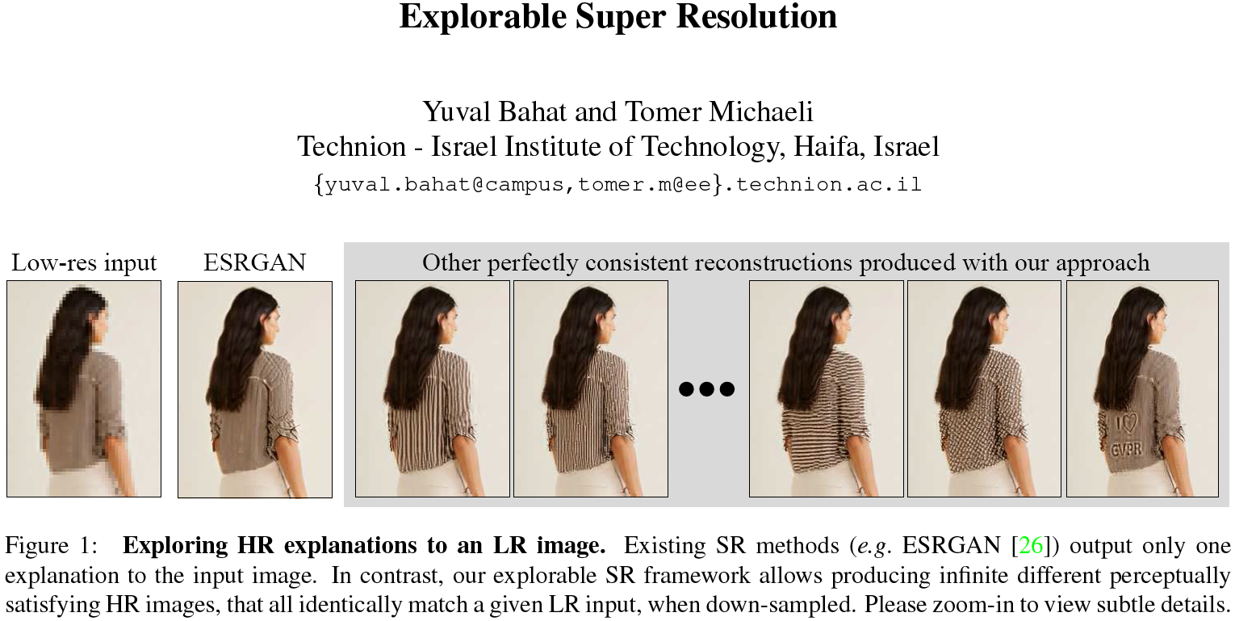

Slide 4
已有的SISR方法无法探索一种LR具有的多种可行的重建结果。
引入新任务：explorable super resolution
Graphical user interface (GUI) + neural network backend, allow editing the SR output to explore abundant plausible HR explanations to the LR input.

Slide 5
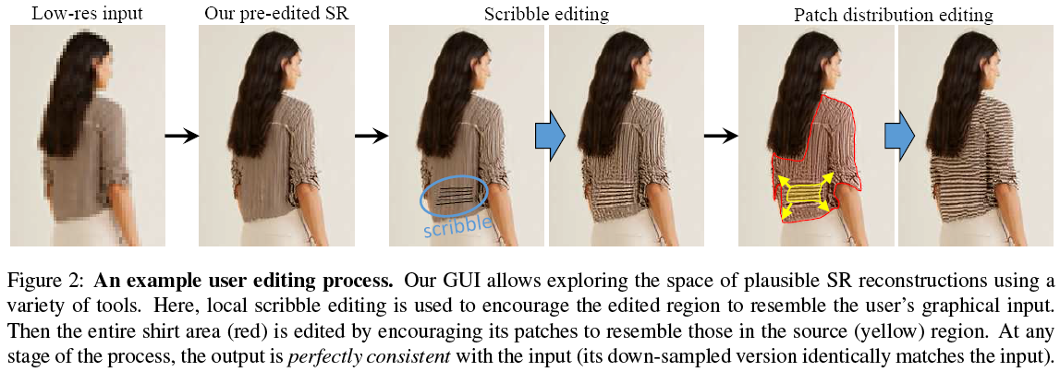

Slide 6
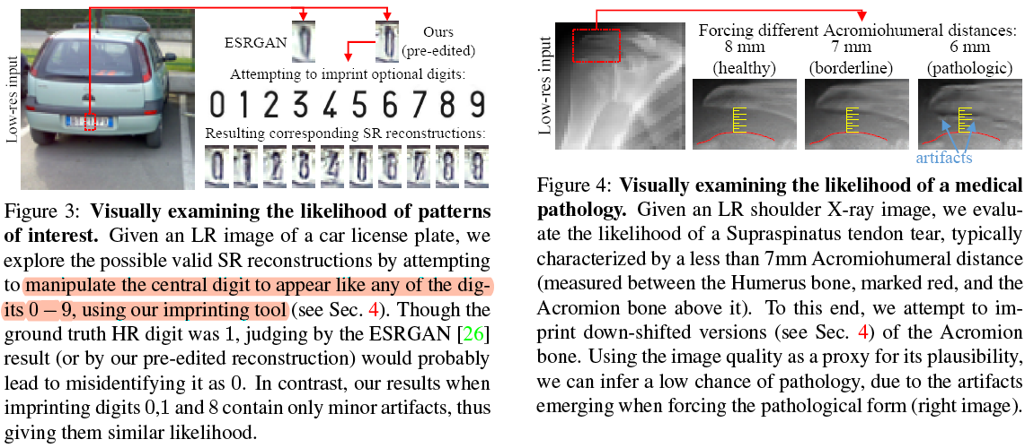
棘上肌腱撕裂
不同的肩峰肱骨间距
Notes:
冈上肌肌腱撕裂

Slide 7
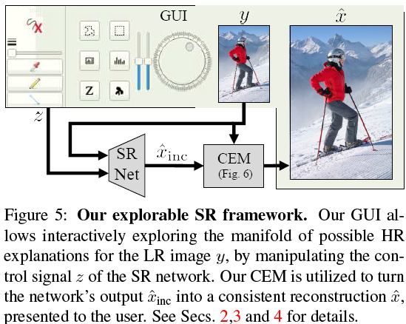
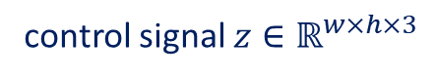

Output image: $\hat{x}∈ℝ^{w×h}$
control signal $z∈ℝ^{w×h×3}$
Concatenate z to the input of each layer of the network, where layers with smaller spatial dimensions are concatenated with a spatially downscaled version of z.

Slide 8
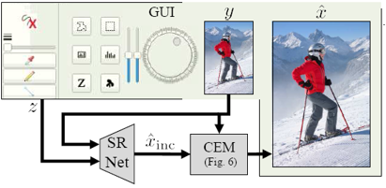
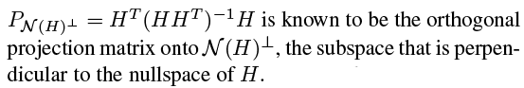
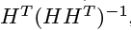
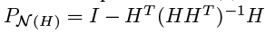
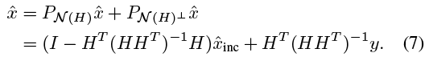
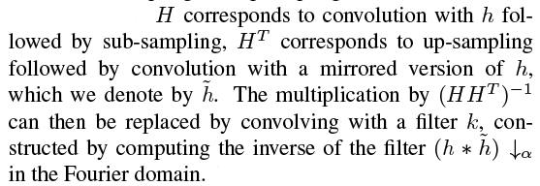
y: a low resolution image. x: unknown high-resolution image. h: a blur kernel. $↓_{α}$ sub-sampling by a factor $α$.
Consistency Enforcing Module (CEM):
multiplying both sides of the constraint in (3) by

Slide 9
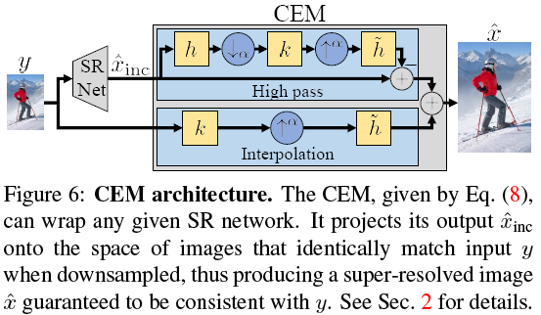
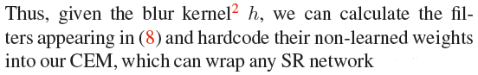
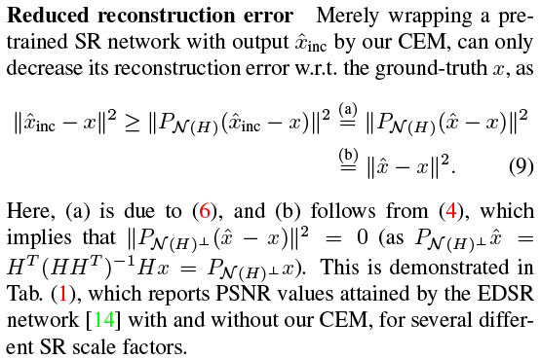
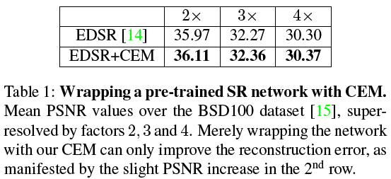
blur kernel: h (bicubic by default)

Slide 10
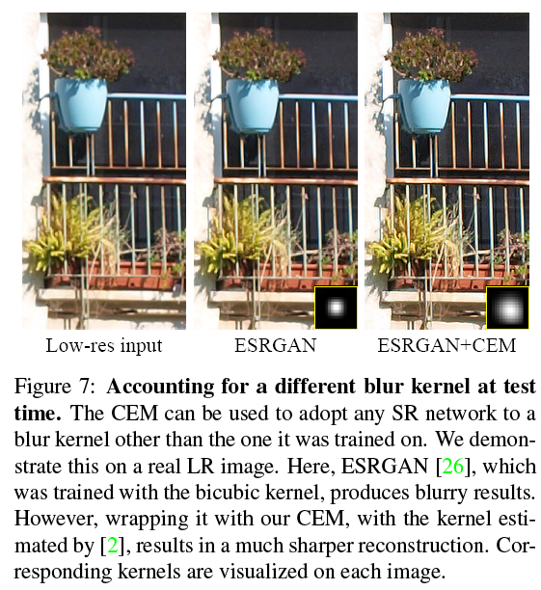
CEM takes the down-sampling kernel as a parameter
upon its assembly at test time. Thus, it can be used for adopting a given network that was pre-trained using some default kernel, to the kernel corresponding to the LR image.

Slide 11
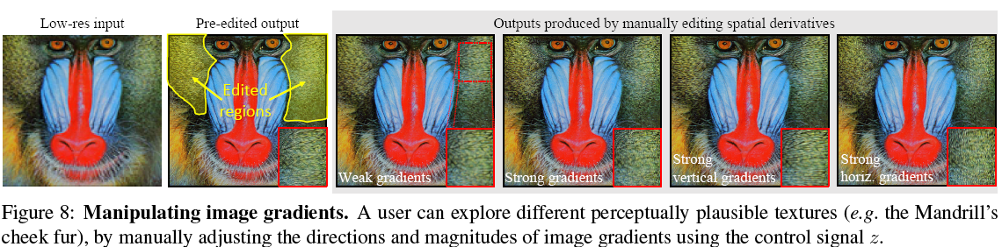
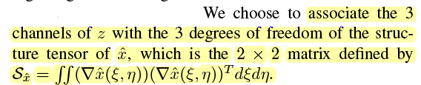
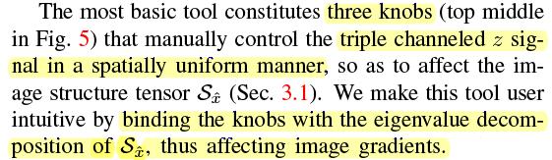

Slide 12
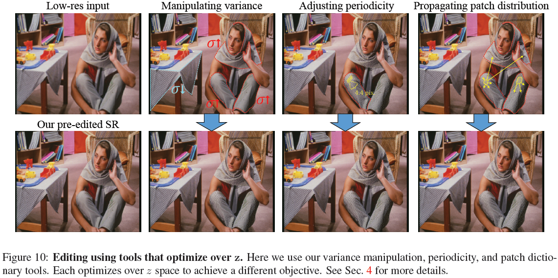

Slide 13
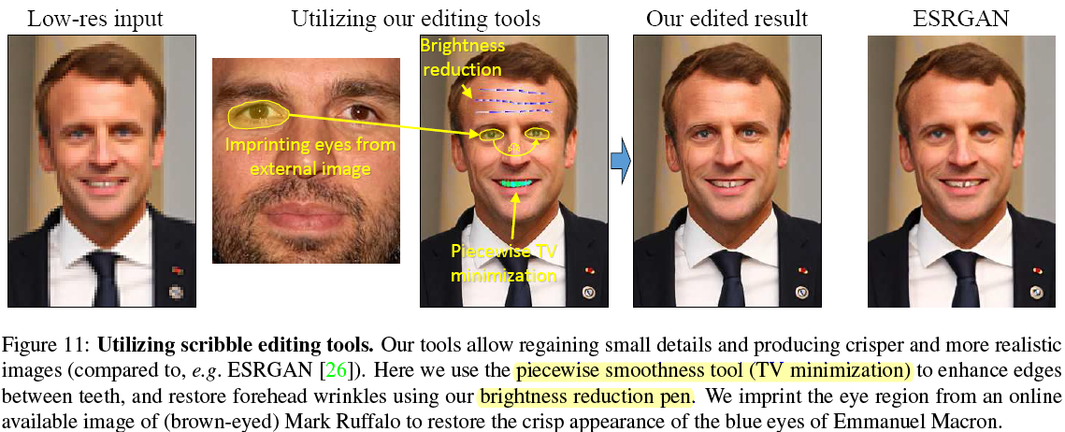

Slide 14
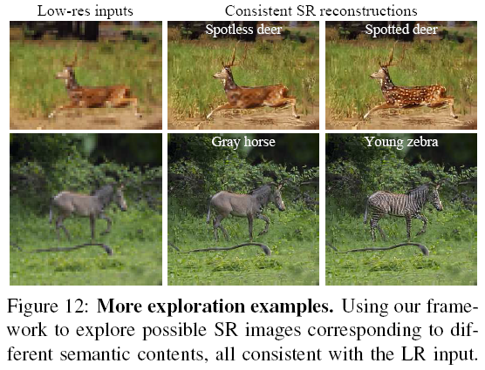
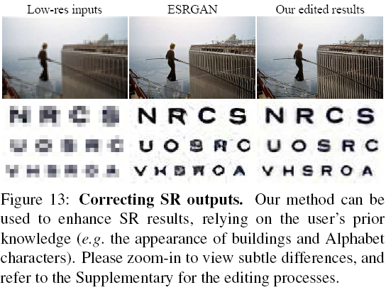

Slide 15
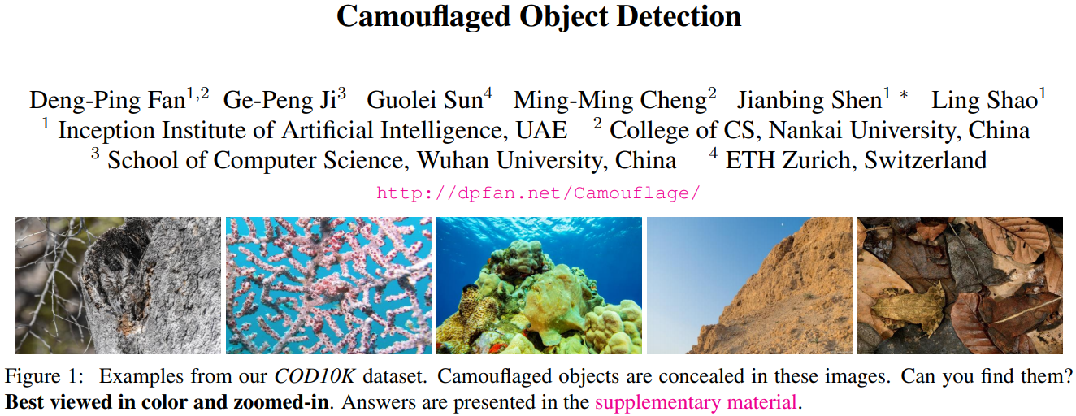

Slide 16
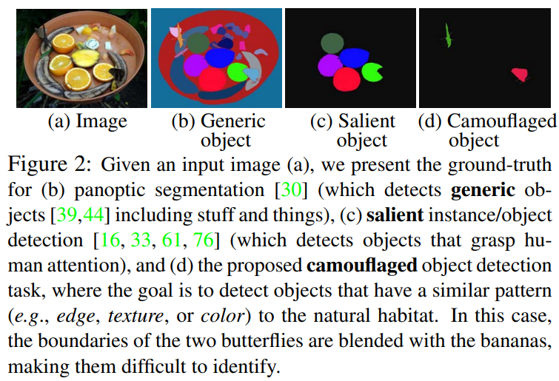

Slide 17
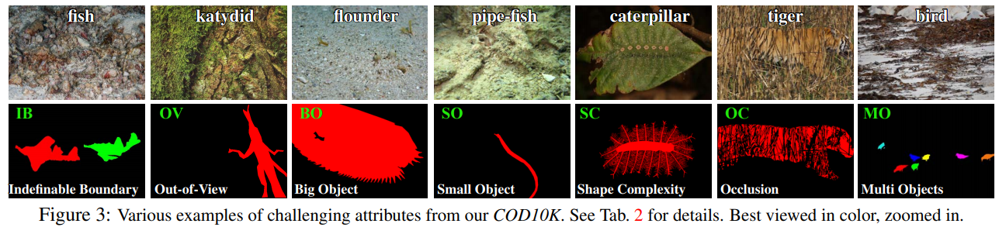
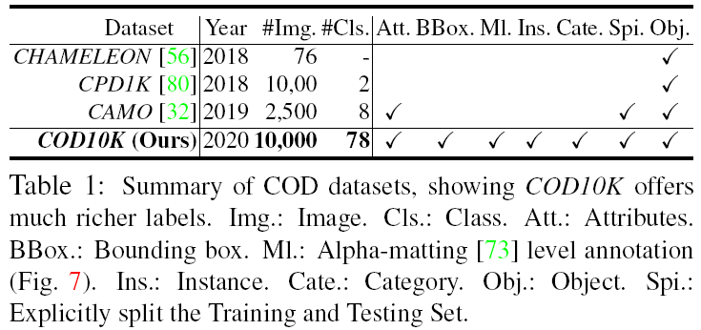
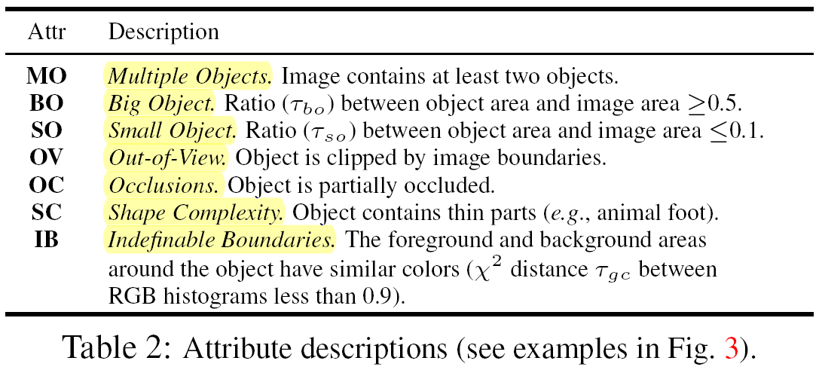

Slide 18
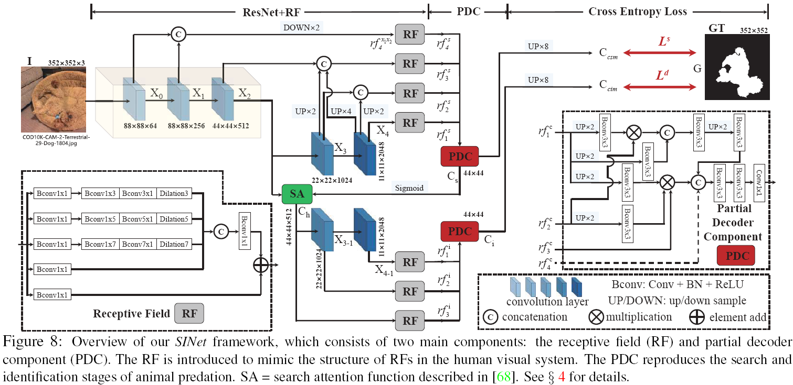

Slide 19
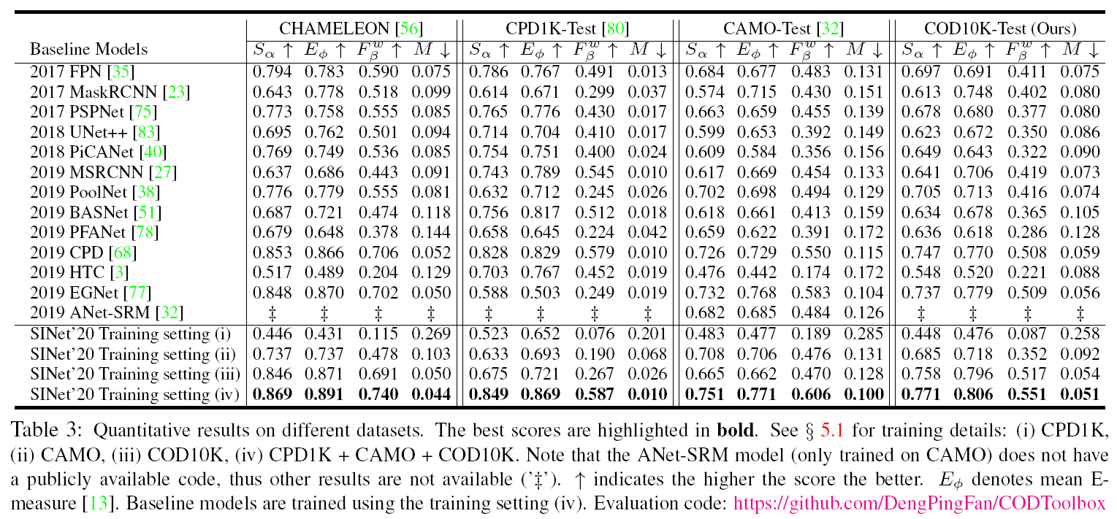

Slide 20
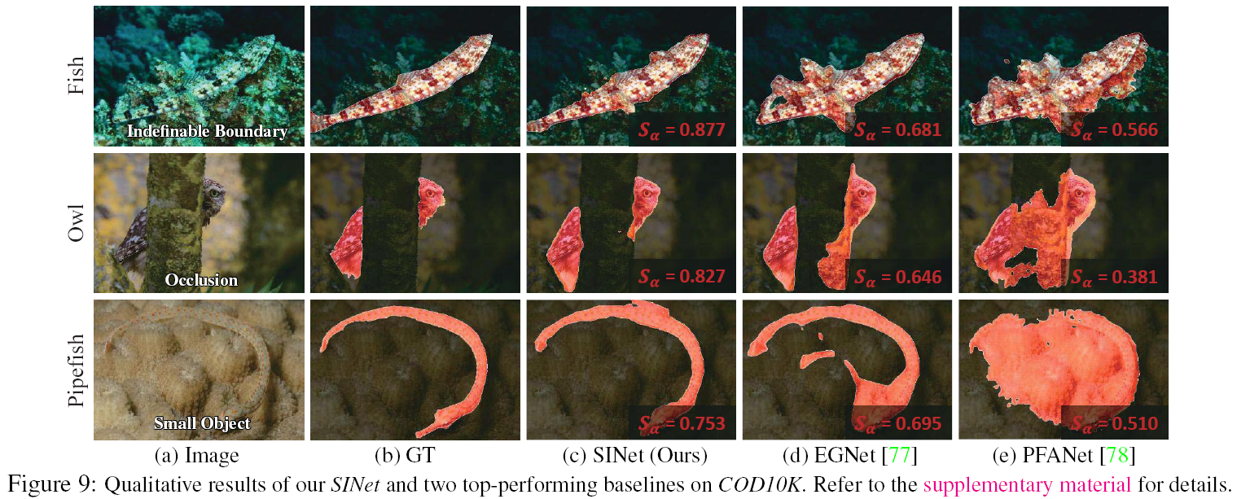

Slide 21
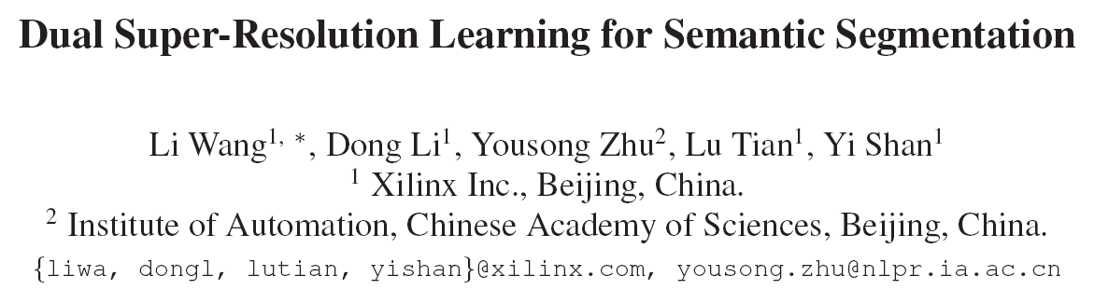

Slide 22
Semantic Segmentation Methods (keep high-resolution representation)
DeepLabs: use atrous convolution to replace strided convolutions.
U-Net: hallucinate higher-resolution feature maps by combining a top-down pathway and lateral connections.
Disadvantages:
(1) Involve expensive computation cost.
(2) take the original high-resolution image as input, increasing the amount of calculation. 当减小input size的时候，分割效果会显著下降。

Slide 23
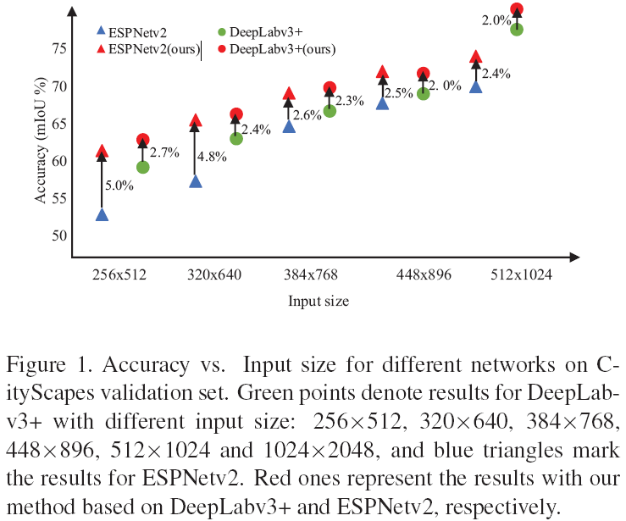

Slide 24
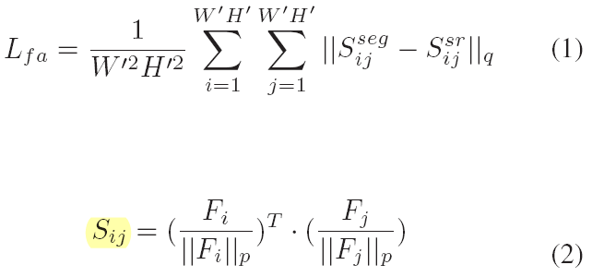
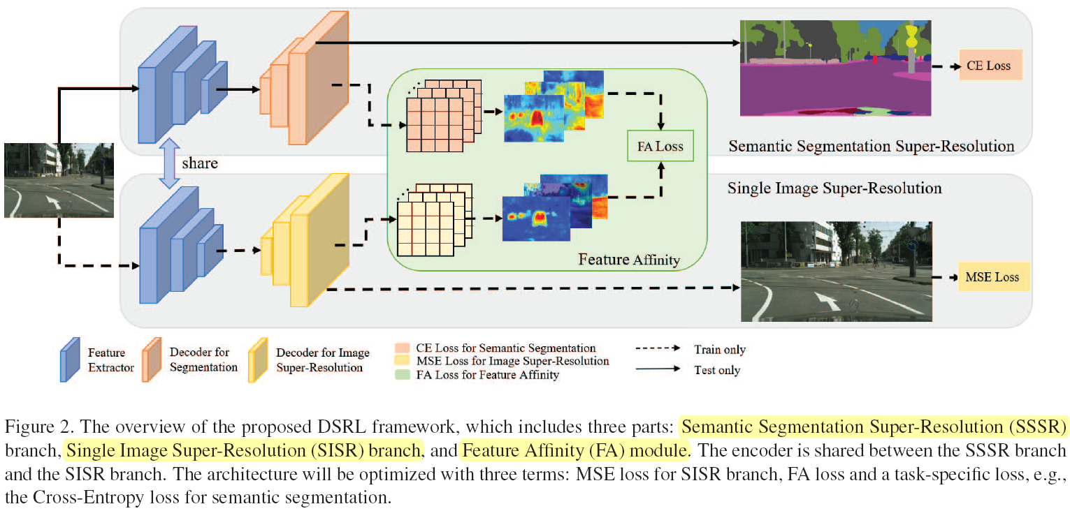

Slide 25
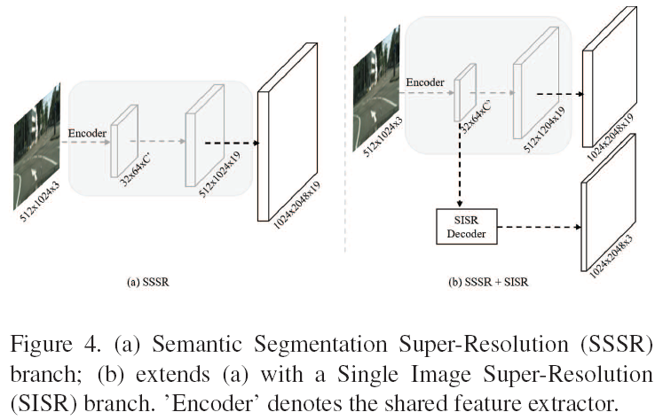
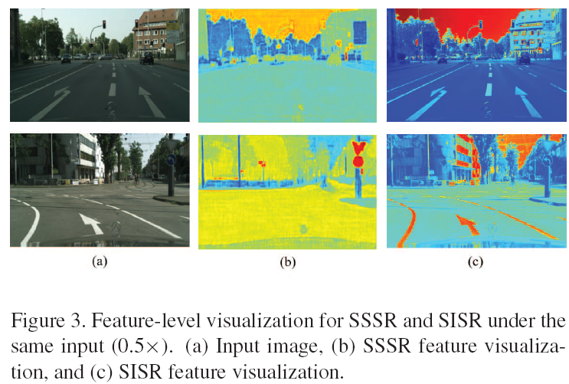
Contain more complete structures of objects
deconv

Slide 26
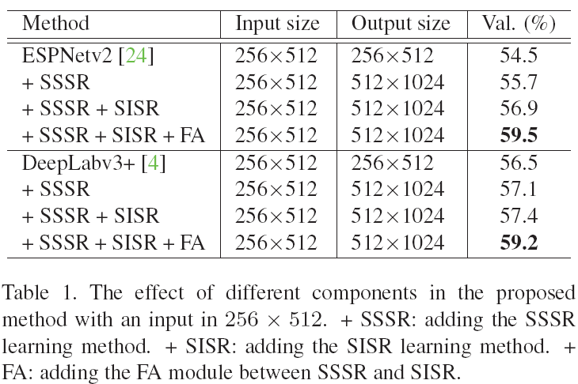
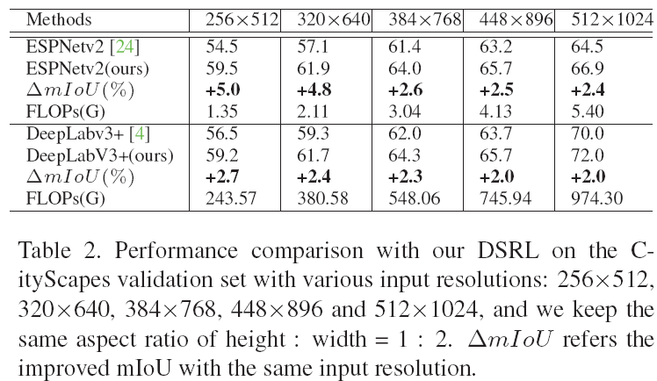
Effect of components
Effect of various input resolutions

Slide 27
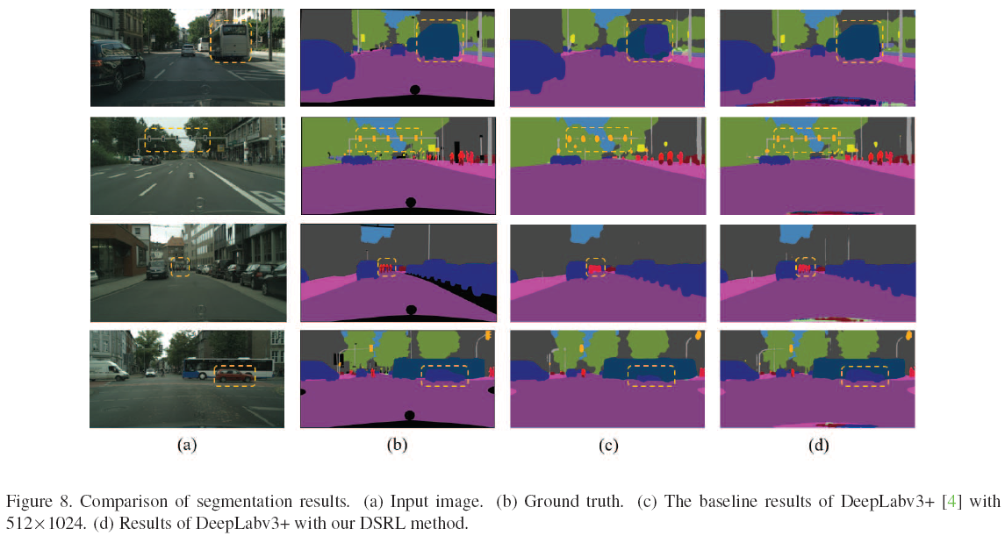

Slide 28
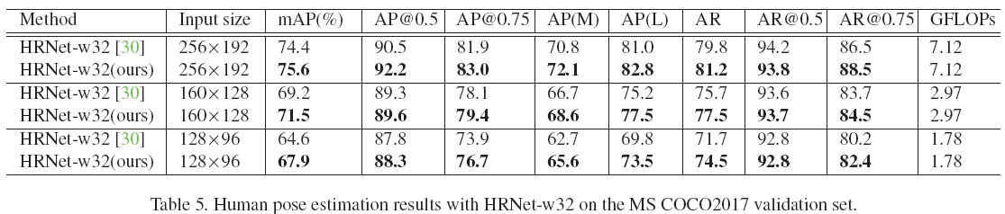
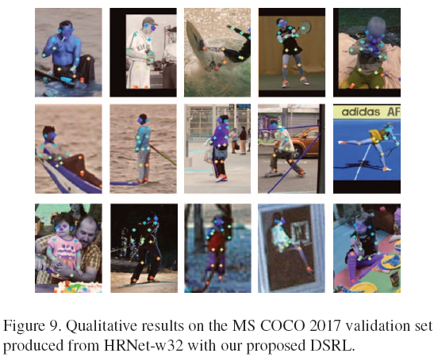
Notes:
Extend to human pose estimation.

Slide 29
Thanks !

